Slide 1
What’s and Why’s of SRE
Assisting our customers in their adoption of world-class SRE practice

Slide 2

Why SRE maturity is Important
1
Reduction in Mean-Time-To-Repair:
SREs improve the reliability of production systems, and reducing MTTR is their top priority. As research shows that 60% of SREs spend most of their time building and maintaining automation code
.
62%
Deloitte SMEs believe
“SRE is about defining ‘reliability’ in terms of customer satisfaction and letting data drive the decisions.”
56%
System of Engagements implementation and 42% System of Record implementations by Google
SRE Principles help Improving 25% of production deployment cycles
Achieve stability and reduce incidents by 75%
2
Focus on Security:
More than two-thirds (nearly 70%) of SREs think that their role in security will become even more central in the coming future. This trend will increase if organizations use third-party libraries for cloud-native app development.
3
Freedom to Experiment:
Experimentation is critical to SRE. While more than half (52%) of SREs dedicate significant of time to designing experiments and tests to reduce the risk of production failure, only 1 in 10 highlights this as their top priority.
4
Shift to SRE-driven engineering
More than half (51%) of SREs dedicate significant time to influencing architectural design decisions to improve reliability. This suggests that organizations have made progress toward SRE-driven engineering across to improve reliability, resiliency, and security.
19% of organisation’s leverage SRE to specific teams for
55% of products and services
SRE Implementation Formula:
Anxiety = 1/Reliability (thereby leading to better customer feedback and client relationships)
5
Reliability - A growing priority:
SRE is expanding beyond just development roles, but with the new socio-technical definition of reliability, teams entirely outside engineering will prioritize it in their process and culture.
Notes:
Talk about genesis of SRE at Google

Slide 3

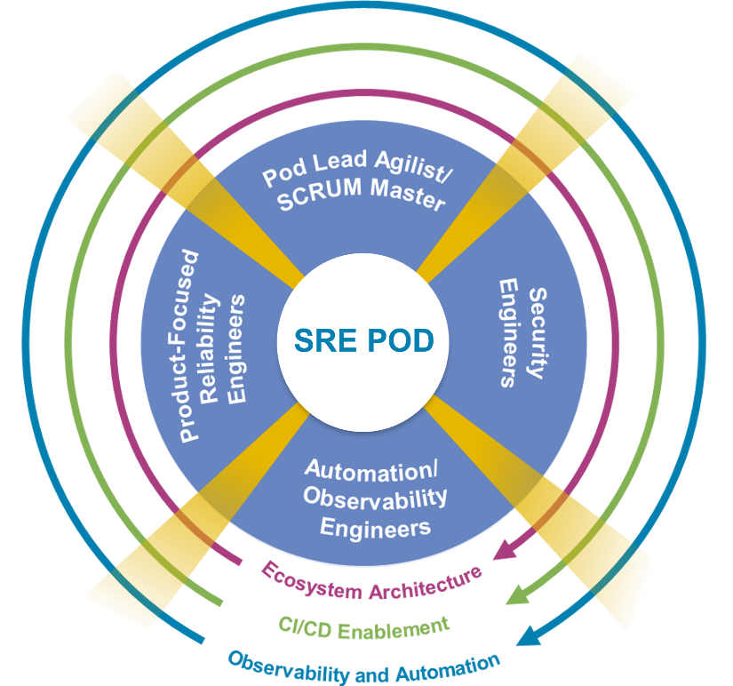



NTT’s Approach to Transformation Journey
context
Current State
Transformation State
Target State
Continuous improvement of SLI/SLO
SRE-as-a-Service with Continuous Improvement
SLI/SLO/EB
Automation
Meaningful dashboards
Enterprise Observability Automation
Data silos
Manual repeated
task
Undefined
thresholds
Feedback on SLO/SLI
Monitoring Tools
Continuous improvement of AIOps
Automation
AIOps
AIOps platform for SRE Operations
Feedback on AIOps
Reactive
Proactive
Predictive
Enterprising

Slide 4
How NTT DATA is helping customers in their Transformation Journey
SRE transformation follows a highly collaborative three-phased approach: Engage, Transform and Evolve
Engage
Evaluate observability platforms to monitor applications and analyse configured alerts
Assess implemented SRE metrics (SLI, SLO and error budget) and available dashboards
Evaluate current processes
Analyse team structure, capabilities and ways of working
Recommend data-backed improvements
Provide a clear “risk versus reward” matrix to prioritise recommendations
Implement proof of concepts (POC) for a selected set of recommendations
Create and provide a roadmap for strategic/ transformational programmes to implement recommendations.
Execute
Define/tweak SLI, SLO and error budget, KPIs on the observability tools
Implement a framework to encourage automation to reduce manual toil
Execute automation based on recommendations from the previous phase
Alert the optimisation
Administer real-time informative dashboards
Define/refine processes, procedures and others
Collect metrics data and baseline threshold
Conduct system and solution increment reviews
Evolve
Flexible NTT DATA SRE PODs plugged with the existing SRE teams to meet varied demand
Regular tweaking of alerts configurations
Regular automation implementation
Constant learning and development of Engineers
Continuation of alignment with value streams
Regular updates of hotspots to various stakeholders
Regular upskilling of the team
Provide day-to-day XLA-based ecosystem support
Outcome/capacity/demand services model ​
Administration support for the technology stack and DevOps toolset
Recommendations via risk-reward matrix
Proof of concepts (POC) for a select set of recommendations
Defined SRE metrics and dashboards
Refine/define SRE processes
Implement automation
Standard operating procedures
Continuous improvements
Flexible NTT DATA SRE PODs plugged in with core customer SRE global teams

Slide 5
Our strategy for tech-resiliency that aligns with our customer’s vision for improving CX/UX​

Slide 6


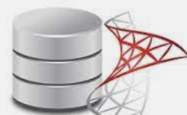



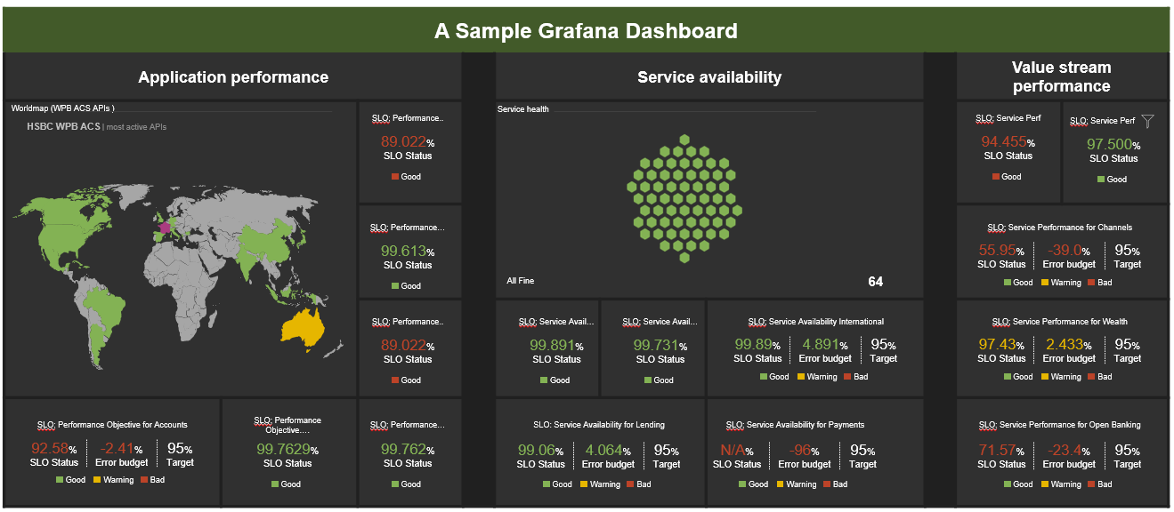
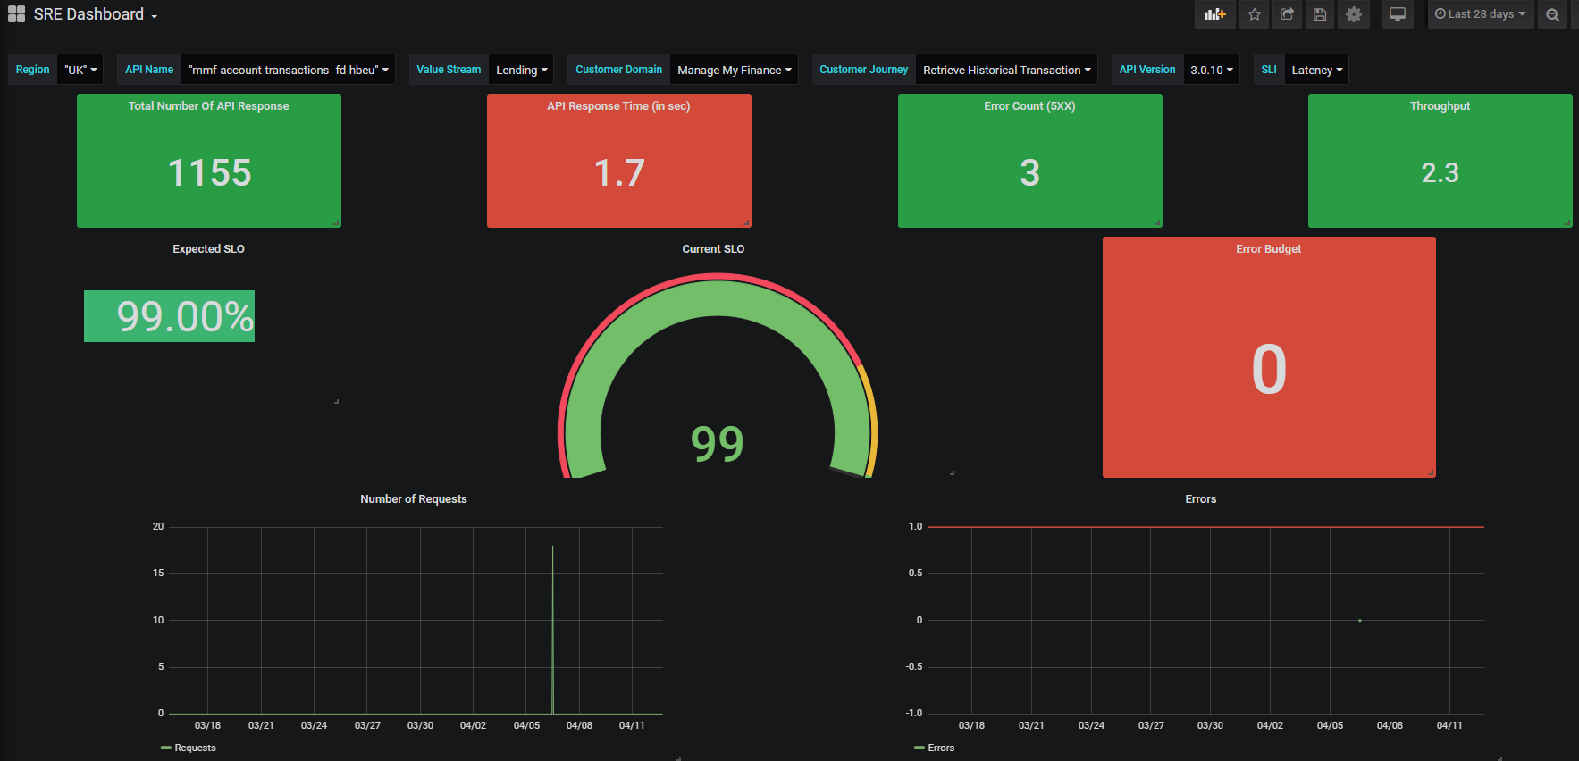



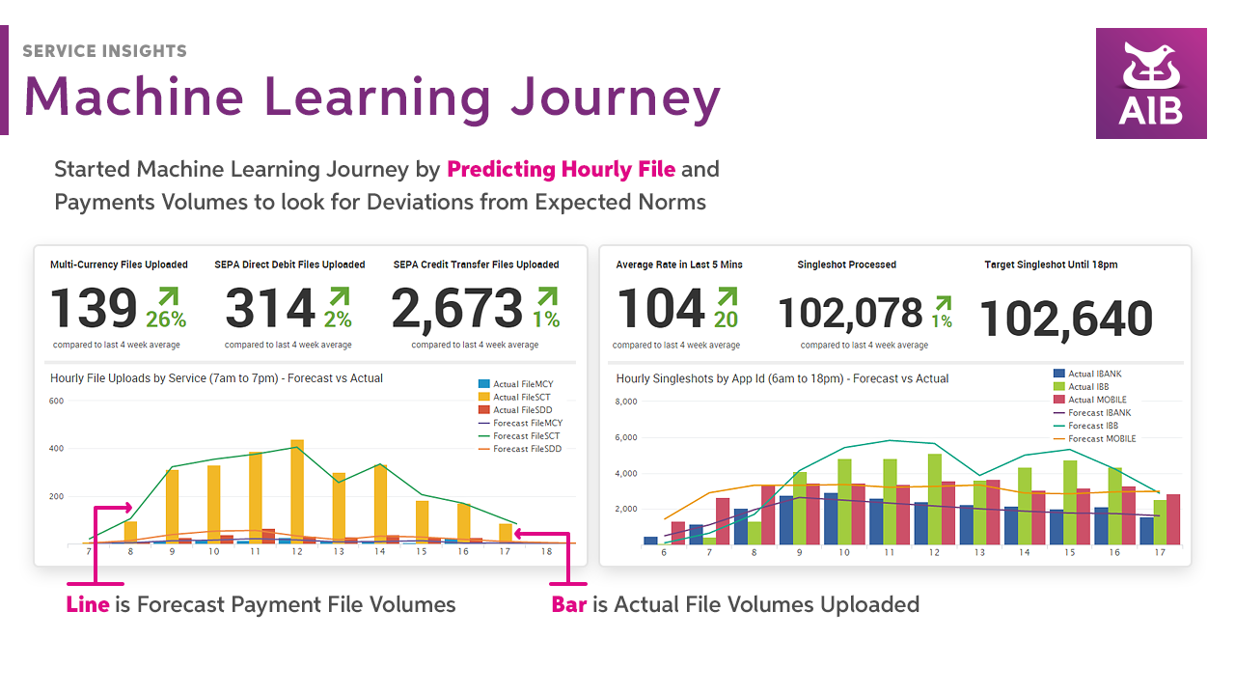
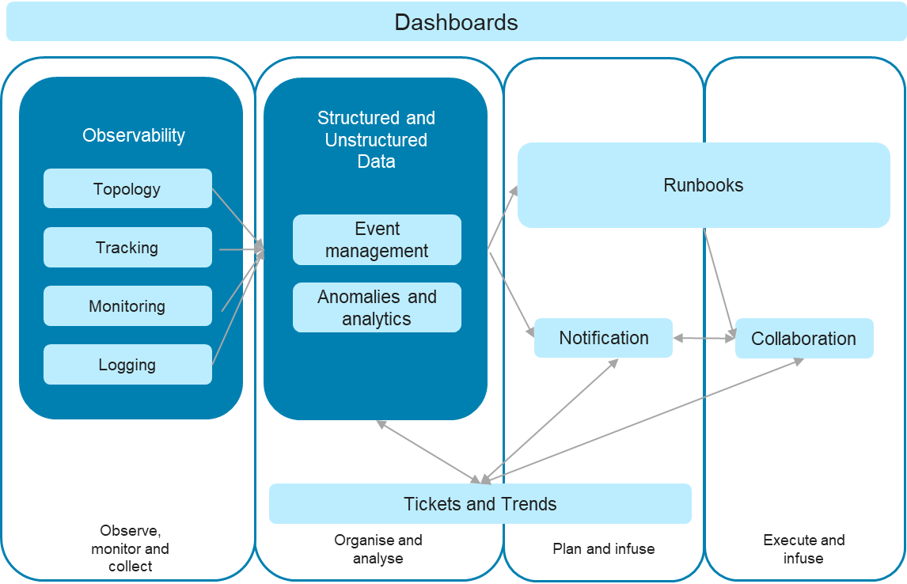
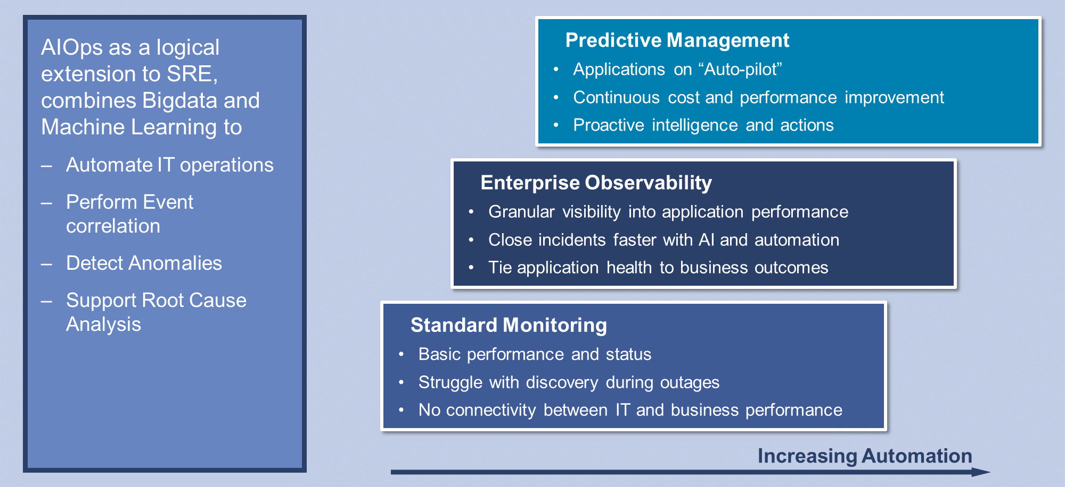
Illustrative Current & Proposed State – SRE Capabilities
Current State
Target State
Efficient Tools Configuration & Monitoring
Correlation of Data
Centralised Platform
Telemetry and Management Layer
Relational DB
NoSQL
Timeseries DB
Data collated from all the monitoring sources to use in Dashboards and feed to ML Algos in customer’s choice of AIOps toolset
Infra Monitoring
Apps Monitoring
ITSM Tool
Other tools (Cert Renewal)
Unified Dashboards
User/ Persona Layer
Clear path and correlation between payment transaction failure and customer impact through Single pane of glass using SRE principles (SLI, SLO, Error Budgets)
Observability
Business Users
Infra Layer
App Layer
Engineering
VM/CMS
Cloud
Microservices
Monoliths
SRE
Bespoke Automation
Actual use case shall be decided post current state assessment. Possible examples – Runbook automation, Certificate renewal, Configuration as a code
Networks
Bare metal
Serverless
Mainframe
Use Case 1
Use Case 2
Use Case 3
Use Case n
Reactive approach to Site Reliability Engineering
Inefficient implementation of monitoring tools – too many false-positives
No single observability platform
Historical alerts & incident data not available as rich monitoring data not shared outside monitoring tools and is discarded within a few weeks.
Undefined automation strategy. Lack of engineering mindset.
Data Analytics
Historical Trend Analytics
Future Projections
Failure Hotspots Identification
AIOps
Self-healing
Predictive Maintenance

Slide 7


Bringing it to life - The “how” of the strategy
“CHAPS High-value Payment” Customer Journey
Channels VS
Wholesale Payments VS
Wholesale Payments VS
Wholesale Payments VS
Enterprise-Tech VS
Online App
Payments Online
Payments Interface
Sanctions
Core Banking Hub
Build
Application
Network
Infrastructure
Middleware
Compute
Microservices App
Network
GCP
Middleware
Compute
C++ based App
Network
Unix
Middleware
Compute
Third-party apps
Network
Infrastructure
Middleware
Compute
AS 400 Mainframe
Network
I-Series Mainframe
Middleware
Compute
Establish SLOs
Define Signaling Standards
Tech Stack
Tech Stack
Tech Stack
Tech Stack
Tech Stack
Normalize Telemetry Data
Recommend for missing Telemetry
SRE Squad 1
SRE Squad 2
SRE Squad 3
SRE Squad 4
SRE Squad 5
Output
Integrated Signaling into SLIs
E2E tracing across journeys
Detailed Telemetry to support drill-down
Consumed by
Automation
Blameless Postmortem
SRE Team
Communication
Fault Isolation

Slide 8
“Talk is cheap. Show me the code.”
Linus Torvalds

Slide 9
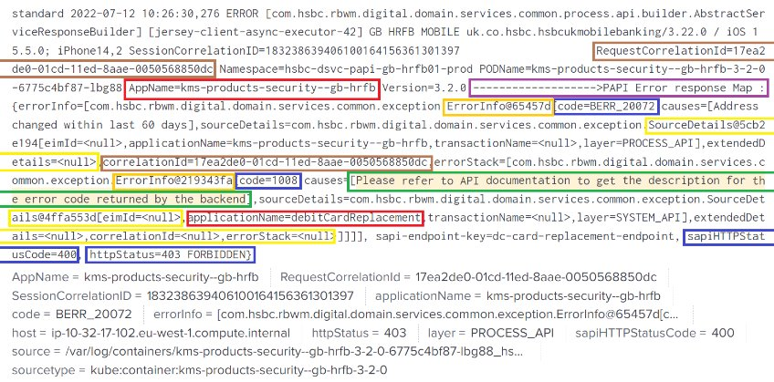
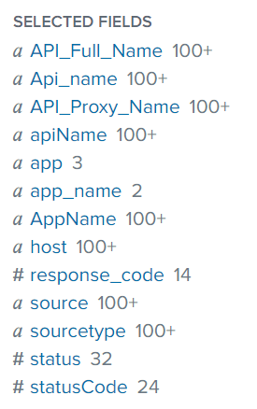
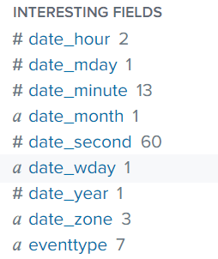
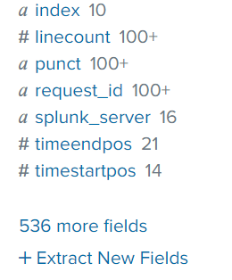
Example of inefficiency in engineering - Logging standards are not followed
When we search logs with an apps Monitoring Tool query index=digital_*
The result should display meaningful fields, but in reality there are around 500 fields; many of them can be avoided by writing better logs. Additional fields will unnecessarily eat up support team’s time to analyse the logs.
When we search logs with Monitoring tool query index=digital_* | transaction ReqCorrelationId maxspan=30s
Result of this query should display each completed or failed transactions in a group of events for that correlation id.
But in reality multiple correlation ids are used:
correlationId
Jwt correlation Id
Session Correlation ID
Request correlation id
X-Customer-Session-Correlation-Id for SESSION_TOKEN
X-Customer-Session-Correlation-Id for ACCESS_TOKEN
X-Customer-Request-Correlation-Id

Slide 10










Example of Automation - End-to-End Cert Renewal Automation POC Architecture
Webhook Triggered on Code Check-in
DNS
VPC (Bare metal)
Internet
Minikube K8s Cluster
https://jenkins.traderyolo.com
Mem-Leak-Java Namespace
GIT Repo
NGINX (Reverse Proxy)
Problem App
Venafi Cert Renewal App
Vault
POD
Spring Boot Cert App
Restart Pod Command
github.wiqram.splunk-Customer-demo
Jenkins Namespace
xMatters
Internet
POD
Redeploy app with new cert and key
Trusted Certificate
Jenkins
Access K8s cluster resources over NodePort OR LoadBalancer
POD
Deploy Config & Refresh Pods
Deploy Agents
XAgent Namespace
xMatters Workflow
Xmatters Free Trial
XAgent
xMatters Alert
Venafi
https://splunk.traderyolo.com
Splunk Namespace
All Pods within Namespace can only access Pods across cluster based on their associated and tagged Service Accounts and access given to those SAs
Splunk
Cert store
Certificate Issuing Authority
Splunk-Connect Namespace
POD
Metrics
Logs
Snyk
Data Collectors
Vulnerability Check
Security check
LetsEncrypt CA
Pushing changes to git
Renew and downloading Cert

Slide 11
But – “Culture eats strategy for breakfast”
Peter Drucker

Slide 12
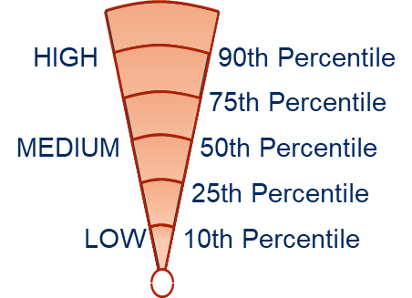

How does an organization’s culture in the context of SRE Enablement looks like?
Predominant behaviour could be somewhere between Conservative, Competitive or Conservative
Key Observations
Scores (out of 10)
Competitive: Aggressive-Defensive Styles
Loyalty and unquestionable adherence to top management’s decision is expected from the team.
Habit of working in a closed group prevails with controlling power in the hands of just a top few.
High pressure environment to deliver outcomes and expectations which results in a latent Authority-Centered competitive culture.
Challenging | 5.6
Authority Centered | 7.6
Performance Driven | 6.8
Perfectionism | 6.4
Task Orientation
Satisfaction Needs
Growth Oriented: Constructive Style
Perfectionism
Goal Driven
Competitive: Aggressive-Defensive Styles
Performance
Driven
Self-
Development
Authority
Centered
Supportive
Conservative: Passive-Defensive Styles
Traditional ways of working are dominant leading to preference towards established norms, approaches and rules.
Feeling of potential criticism guides individual’s actions, requiring them to seek approval before every decision.
Strong dependence is there on team leaders, absence to which leads to anxiety among team members.
Approval Seeking | 8
Traditional | 9.2
Reliant | 7.4
Cautious | 5.6
Challenging
Collaborative
Conservative: Passive-Defensive Styles
Cautious
Approval
Seeking
Growth Oriented: Constructive Style
Reliant
Traditional
Strong focus on meeting personal & organizational goals with a sense of accountability. (This behavior also stems from a competitive environment)
Willingness for developing new skills and grasp opportunities.
Individuals are supportive, however will not go out of their way to help.
In situations of issues, individual accountability is considered very important to resolving them.
Goal Driven | 7.4
Self-Development | 6.4
Supportive | 4
Collaborative | 6.4
Security Needs
People Orientation
OCI circumplex from Robert A. Cooke and J. Clayton Lafferty, Organizational Culture Inventory®, Human Synergistics International. Copyright © 1987-2009. All rights reserved. Used by permission.
Note: None of these traits are “good or bad” in themselves. Keeping in view that we are focusing on the behavioral traits that enable SRE Principles – scoring high on Competitive shows misalignment to SRE ways of working & a Growth-Oriented high score is ideal for SRE. Being a global bank, scoring high on Conservative is expected.
Notes:
Having investigated the 64 variables and the responses we received – we collated the latent behavioral traits most prevalent within the Value stream in HSBC.
Given that, the business context is a Bank, it was not surprising that the predominant behavior is Conservative.
Bear in mind, none of these traits are “good or bad” in themselves. Keeping in view that we are focusing on the behavioral traits that enable SRE Principles, we would like to draw attention to certain characteristics…
Key observations :
[Constructive] We found several pockets of growth-oriented behaviors, that support SRE Principles. Goal-Driven; keen to collaborate…
[Constructive] Supportive and Collaboration areas were found to be less prominent – which points to silo-ed area of focus … only looking at a limited Operations view, not wholistic areas …
[Constructive] While there is a strong desire to learn, develop skills, the focus is more on individual areas.
[Competitive] There is a latent dominance of authority-centered, performance-driven, and perfectionistic traits.
[Competitive] This has unintended consequences, such as limiting innovation, individuals are under heavy pressure to focus on their individual component of the ecosystem – driving “silo” mindsets.
[Competitive] Indicators pointing to psychological safety and promoting blameless postmortems were found to be short in supply.
[Conservative] “fear of failure” Indicators were found amongst the responses from the team members – there was a tendency to find comfort in approvals and reliance on traditional hierarchies.
[Conservative] narrow-concentrated decision-making has the consequence of limiting proactive problem-solving.
I will take you through the first segment… and then I will request Prashita and Tanvi to cover the other two segments…

Slide 13

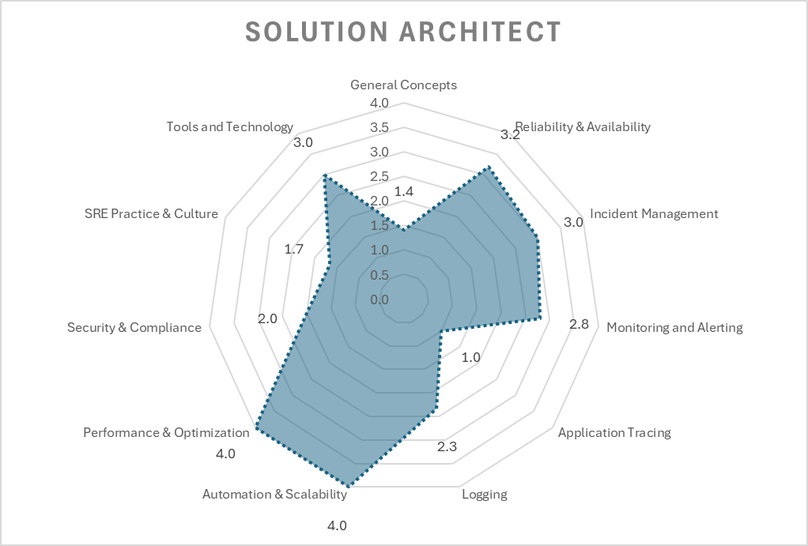
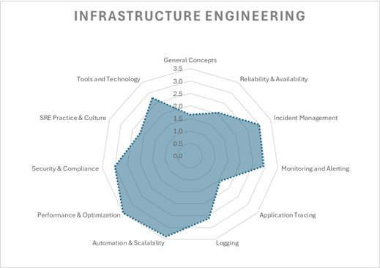
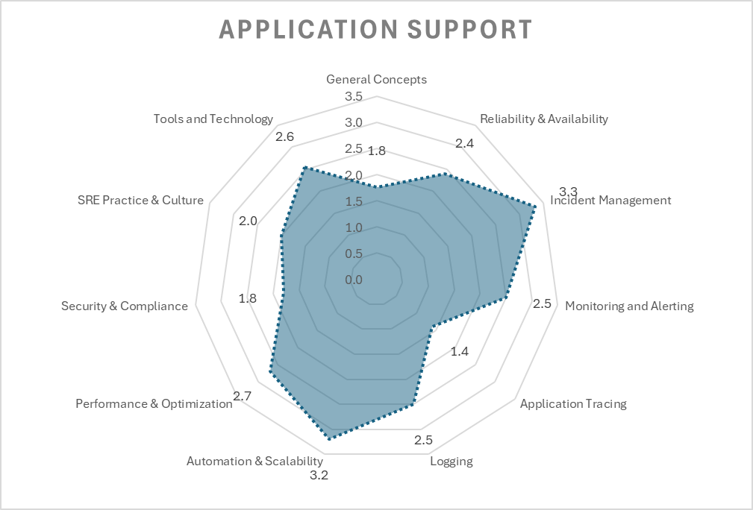
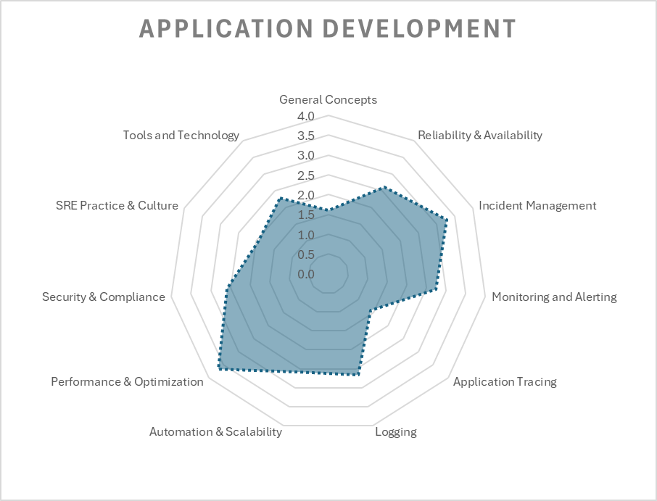
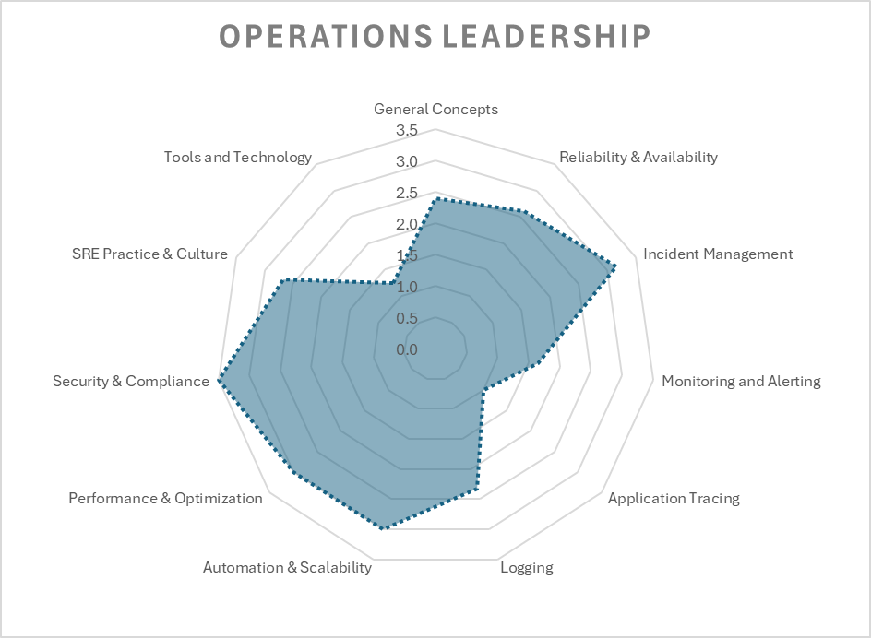
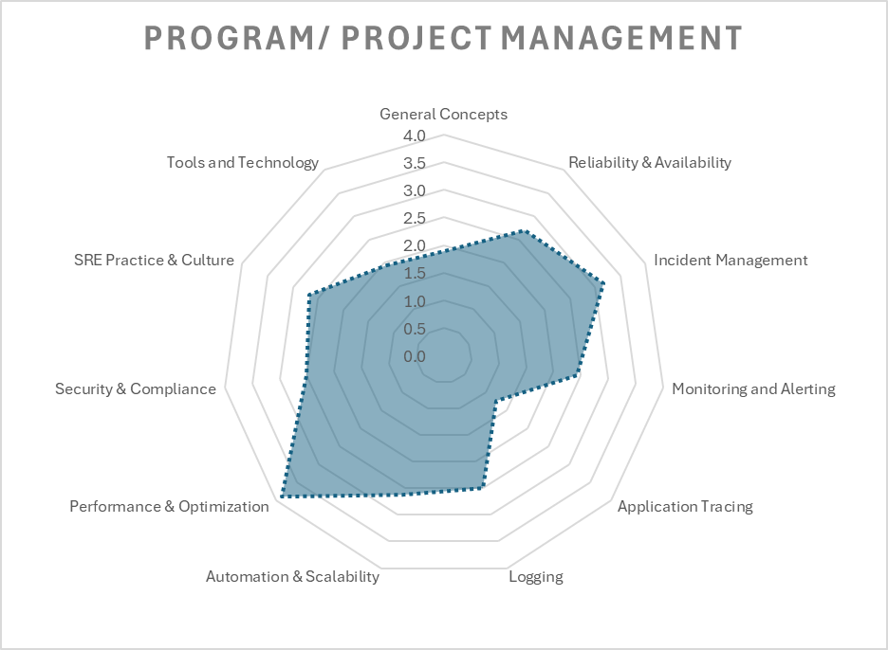
Radar Charts of SRE Questions: by Dimension
Observations of grouped results display similar patterns of strengths and weakness, although certain
strengths and weaknesses may be amplified based on the target group

Slide 14
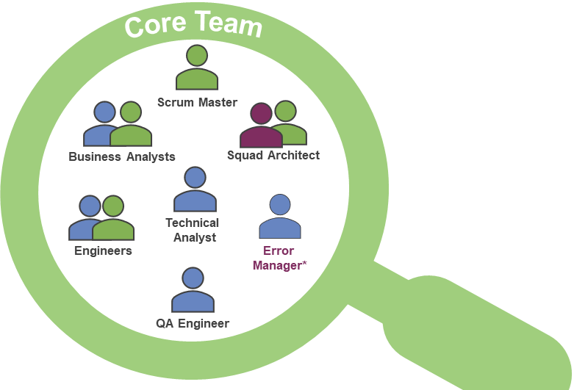
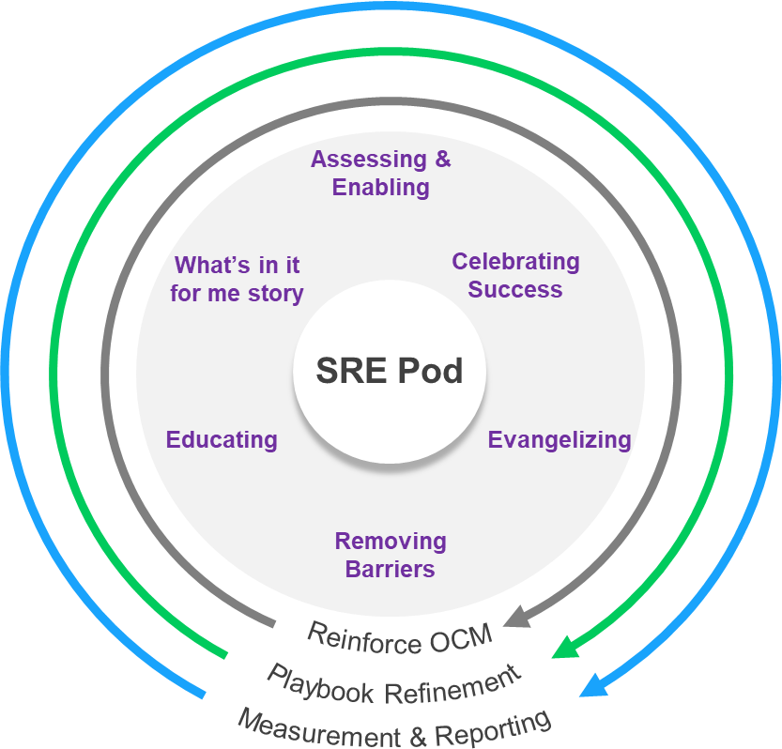
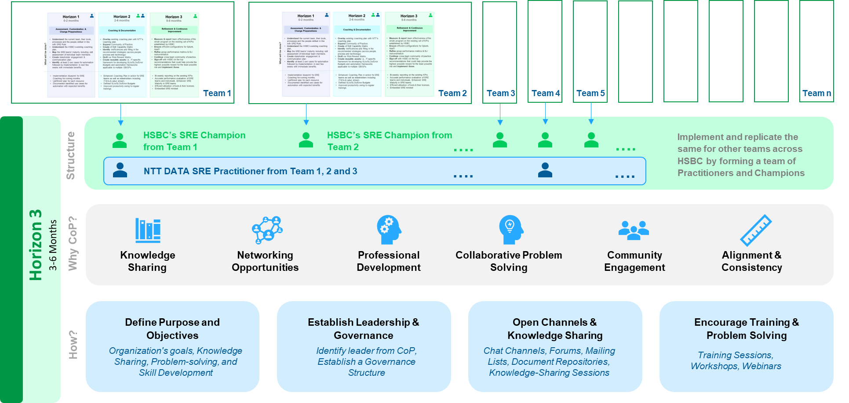

Our approach to build SRE maturity (People + Culture)
Assessment, Customization & Change Preparedness
What we have
What we need
Kick-off to set expectations
Comparative assessment of all 3 teams to understand what is working for them & identify gaps
Customer’s SRE Framework & Training Modules
Ways of Collaboration
Decision Making
Guiding principles
Agree on success metrics to be tracked
Baseline the selected metrics
How was this rolled out? – Trainings, reinforcement activities
What were the prior roles / skill sets of the members - skill maturity at start vs now
What inefficiencies were taken off the table right away?
What additional training is available for skill gaps?
What aids cross-team collaboration? Are there SRE-specific values, rituals followed?
Who are the identified SRE leaders to become SRE champions?
Who are the stakeholders outside of the teams and their degree of involvement?
Pre-requisites
Customer’s baseline metrics & KPIs
Identify 2 target teams for SRE maturity upliftment, one “control” team
Week 1 to Week 6
Key Considerations
Horizon 1
Lessons learnt from WPB ACS and Wholesale GPS
Mission Critical Apps
2 Target Teams
1 Control Team
(Role Model SRE Team)
Different Geographies
Different GB GFs
Develop POVs & Roadmap
What we “know”
What needs to be done
Why, When and How it needs to be done
Receive, Discuss, & Refine
Refinement & Continuous Improvement
Execution
Socialize POVs
(Show & Tell)
Refined Playbook
Customer SRE Champions leading SRE Maturity
Implement POVs
Wider Customer
Week 13 to Week 24
Week 6 to Week 12
Templates for assessments
Implementation steps
Use Cases for automation
Ideal team structures
Training modules
Communication plan
Horizon 3
Horizon 2
Community of Practice to ensure continuity & scale
SRE Embedded
Reinforcement & Continuous Improvement in progress
Refined Playbook
© 2024 NTT DATA, Inc.

Slide 15
NTT Accelerators – Helping our organisations embrace the SRE practice quicker

Slide 16
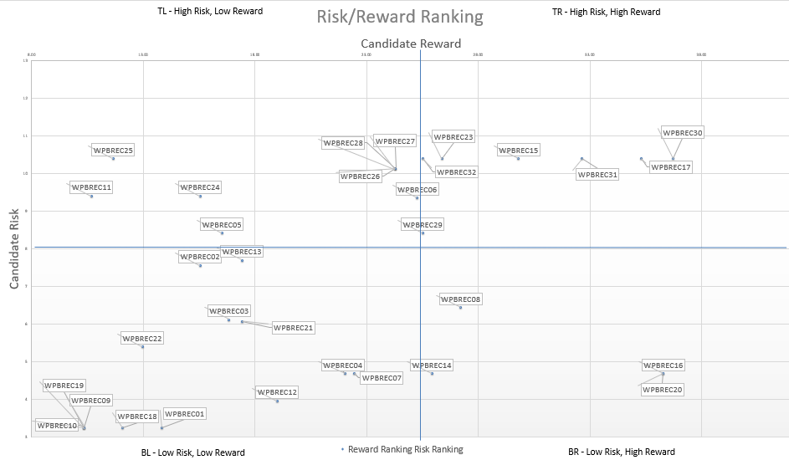

NTT DATA’s SRE Accelerators
Risk – Reward Matrix
Baseline SRE Metrics
SLI, SLO and Error Budget are crucial components of SRE. They help quantify the performance and reliability of services and set expectations for users and stakeholders. We have defined templates for the metrics (VALET) that can be used for a quick baseline setup.
V=Volume;
A=Availability;
L=Latency;
E=Errors;
T=Tickets
Accelerators
Quick Win Automations
SPoG & Integration
Splunk Configuration Changes
Pipeline that can be integrated to enable a configuration-as-code approach for managing Splunk settings. This streamlines the process of updating and maintaining Splunk configurations.
Certificate Renewal –
Microservice that automates the renewal of certificates hosted on Venafi. The service ensures the timely renewal of certificates and automatically pushes updated certificates to the relevant application repositories.
And Many More…
Single Plane of Glass
Comprehensive observability strategy is necessary for effective SRE. We have predefined dashboards in Grafana (an open-source tool) for SRE that can be reused by importing JSON files
Integration Scripts
We have developed tool-agnostic Python scripts that facilitate connections to various sources, such as Splunk, AppDynamics, InfluxDB, and more, enabling the retrieval of key application performance metrics and data transmission to databases.

Slide 17


Dashboards
Define and implement the dashboard for each API related to SLO and Error Budgets defined in 1.1.
A Sample Grafana Dashboard
Application performance |  |  |  | Service availability |  |  |  | Value stream performance
Worldmap (Value Stream APIs )
SLO: Performance..
Service health
SLO: Service Perf
SLO: Service Perf
Customer Value Stream | most active APIs
89.022%
SLO Status
94.455%
SLO Status
97.500%
SLO Status
A global view of the most active Application
Good
Good
Good
SLO: Performance…
SLO: Service Performance for Channels
99.613%
SLO Status
55.95%
SLO Status
-39.0%
Error budget
95%
Target
Good
All Fine
64
Good
Warning
Bad
SLO: Performance..
SLO: Service Avail…
SLO: Service Avail…
SLO: Service Availability International
SLO: Service Performance for Wealth
89.022%
SLO Status
99.891%
SLO Status
99.731%
SLO Status
99.89%
SLO Status
4.891%
Error budget
95%
Target
97.43%
SLO Status
2.433%
Error budget
95%
Target
Good
Good
Good
Good
Warning
Bad
Good
Warning
Bad
SLO: Performance Objective for Accounts
SLO: Performance Objective….
SLO: Performance…
SLO: Service Availability for Lending
SLO: Service Availability for Payments
SLO: Service Performance for Open Banking
92.58%
SLO Status
-2.41%
Error budget
95%
Target
99.7629%
SLO Status
99.762%
SLO Status
99.06%
SLO Status
4.064%
Error budget
95%
Target
N/A%
SLO Status
-96%
Error budget
95%
Target
71.57%
SLO Status
-23.4%
Error budget
95%
Target
Good
Warning
Bad
Good
Good
Good
Warning
Bad
Good
Warning
Bad
Good
Warning
Bad
Represents the defined SLO for a value stream
Represents the Error Budget left before it can impact the service
The error budget dashboard will help PM and team in identifying whether the API needs some attention like fixing it (depleted error budget) or it can handle more frequent feature releases
The SLO dashboard will help SRE in identifying, whether the API has a high impact (for example, an SLO of 99.999) and alert/incident related to it, is of the highest priority and need to fix it first
Notes:
Speaker: Vikram
Mark and Aleks can use these dashboards without any intervention of any of the SRE team members. They can use this to provide data backed information to senior stakeholders.

Slide 18
Industry Standard Metrics for Measuring the Effectiveness of an entire IT Estate
Business Channel
Average lead time (ALT) | Work-in-progress (WIP) | Percentage change user volume (CUV) | Average process time (APT) | Average wait time (AWT) | Mean time to restore (MTTR)
Development Channel
Test coverage percentage (TCP) | API reuse rate (ARR) | API consumption rate (ACR) | Build failure frequency (BFF) | Rework rate (RR) | Commit to prod deployment latency time
Build duration (BD) | Build frequency (BF) | Defects volume (DV) | Code analysis defects (CAD) | Commit frequency (CF) | Number of story points
Average failed deployment rate (FDR)* | Number of deployments/day (DPD)* | Percentage failed deployment | Average failed release rate (FRR) | Number of releases/day (RPD) | Percent failed release
Operations Channel
Automated detection rate (ADR) | Average build failure frequency (ABFF) | Average cycle time (ACT) | Average change volume (ACV) | Daily change rate (DCR) | Defect burndown ratio (Open/Closed)
Open by technology (OBT) | Mean time to detect (MTTD) | Mean time to diagnose | Mean time to resolution (MTTR) | Mean time between failure (MTBF) | Average response time
Availability | Raw downtime minutes | Mean time between incidents (MTBI) | Average number of open incidents/day | Average number total incidents/day (IPD) | Average number of incidents close/day
IaC request to deployment average latency time | Percentage IaC latency threshold achieved | Percentage CaC requests to deployment latency time | Percentage CaC latency threshold achieved
Security Channel
Number of unpatched known vulnerabilities | Frequency which employee access reassessed | Percentage of cyber resources properly configured | Average time to Patch | Average time from patch release to patch installation | Percentage of the critical incident where pre-planned responses exist
Percentage of vulnerabilities checked for compliance | Average time to mitigate known vulnerability
Reliability
Four channels:
Business Channel
Development Channel
Operations Channel
Security Channel
Widely used Metrics
Other Metrics
Metrics Management Approach
Engage Phase: Identify and establish a metrics strategy
Execute Phase: Data collection and baselining of threshold
Evolve Phase: SLA tracking and reporting, re-baseline through change management
Notes:
Speaker: Vikram

Slide 19
NTT DATA’s SRE Accelerators
Risk – Reward Matrix:
The Risk-Reward Graph:
Recommendations:
Recommendation Tag | Recommendation Detail
WPBREC01 | Disabled alerts should be removed from production environment
WPBREC02 | Testing of alerts should not be done in the production environment
WPBREC03 | Key value pair should be standardized. For example use application_name or related naming convention as a standard term
WPBREC04 | Splunk and AppDynamics integration - Significance of integration 1. Helps in correlating AppDynamics data with Splunk logs 2. Push notifications on policy violations and events from AppDynamics 3. Helps in quicker resolution of the issues
WPBREC05 | Alert creation should follow common standards

